Slide 1
COMP 53 – Week Three
Separate File Compilation
Intro to Pointers

Slide 2
Topics
How to Handle Large Projects
Header Files
Class Files
Main() program
It’s not polite to point
Except when dealing with memory!

Slide 3
Why Do We Care
Multiple source files
Source code can quickly get out of hand
Enable multiple people to work on projects at same time
Pointers
Need to reference large blocks of memory with simple variable
Ease parameter passing

Slide 4
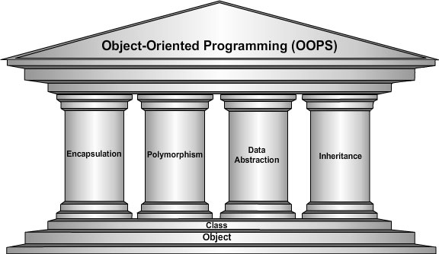
Learning Objectives – Intro to OOP
Notes:
Information Hiding
Details of how operations work not known to "user" of class
Data Abstraction
Details of how data is manipulated within ADT/class not known to user
Encapsulation
Bring together data and operations, but keep "details" hidden

Slide 5
Class Separation
Interface
Class Definition
Program 2
Program 1
Black box approach → Change the implementation without program impact
This is the specification of what the class does. Placed in a header file

Slide 6
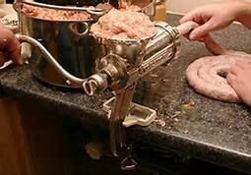
Encapsulation Rules
All member variables should be private
Basic class operations should be:
Public member functions
Overloaded operators
Group class definition and prototypes together
Called "interface" for class
Make class implementation unavailable to users of class

Slide 7
Class Header Files
Contains the Class interface
Use .h naming convention
Programs that use class will "include" it
#include "myclass.h"
Quotes indicate you wrote header
Find it in "your" working directory
Recall library includes, e.g., <iostream>
< > indicate predefined library header file
Find it in library directory

Slide 8
Class Implementation Files
Class implementation in .cpp file
Name interface file and implementation file the same
myclass.h and myclass.cpp
All class’s member function defined here
Implementation file must #include class’s header file

Slide 9
Driver (main) Program
Also called the Application File
Need to have #include “myclass.h” at top
Allocate class objects and call methods as needed
Organization of files is system dependent
Typical IDE has "project" or "workspace"
Implementation files "combined" here
Header files still "#included"

Slide 10
Separate Compilation in Practice
Header File
Class Defn File
Main.cpp
Compile
Compile
Program Parts
Kept in separate files
Compiled separately
Linked together before program runs
Class definitions
Separate from "using" programs
Build library of classes
Re-used by many different programs
Just like predefined libraries
Link
Executable File

Slide 11
Multiple Compiles of Header Files
Problem:
Header files typically included multiple times
e.g., class interface included by class implementation and program file
Must only be compiled once!
No guarantee "which #include" in which file, compiler might see first
Solution
Use preprocessor
Tell compiler to include header only once
#pragma once
Notes:
Each implementation of C and C++ supports some features unique to its host machine or operating system. Some programs, for example, must exercise precise control over the memory areas where data is put or to control the way certain functions receive parameters. The #pragma directives offer a way for each compiler to offer machine- and operating system-specific features while retaining overall compatibility with the C and C++ languages. The number sign (#) must be the first non-white-space character on the line that contains the pragma; white-space characters can separate the number sign and the word "pragma". Following #pragma, write any text that the translator can parse as preprocessing tokens.
This can reduce build times as the compiler will not open and read the file after the first #include of the module.

Slide 12
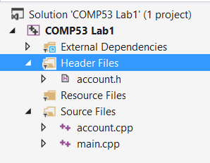

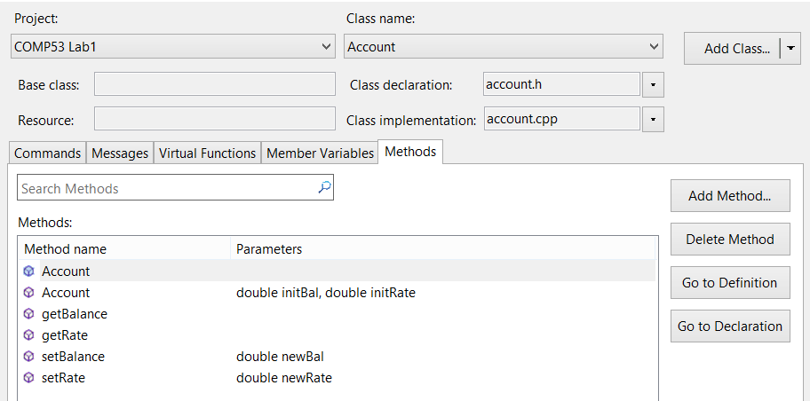
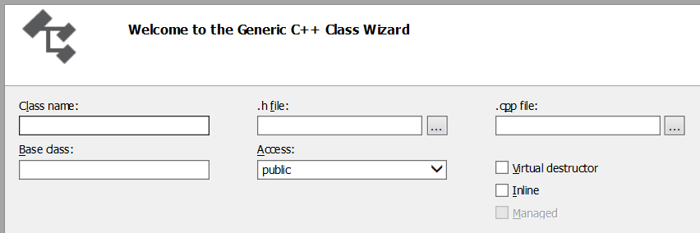
When You Need Help – Ask the Wizard
Right click on Header Files. Click on Class Wizard…
Press Add Class button to define a new class
Specify the name of the class. The .h and .cpp names should default

Slide 13
Pre-processor Directives Using #ifndef
Tell the compiler what statements to include in program
Header file structure:
#ifndef FNAME_H #define FNAME_H … //Contents of header file … #endif
FNAME typically name of file for consistency, readability
This syntax avoids multiple definitions of header file

Slide 14
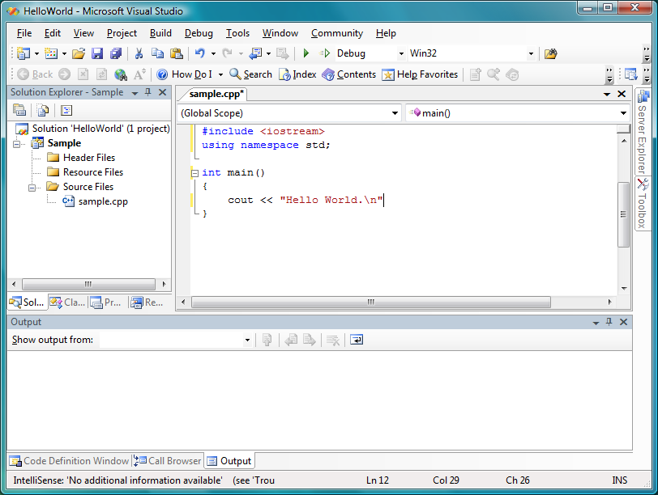
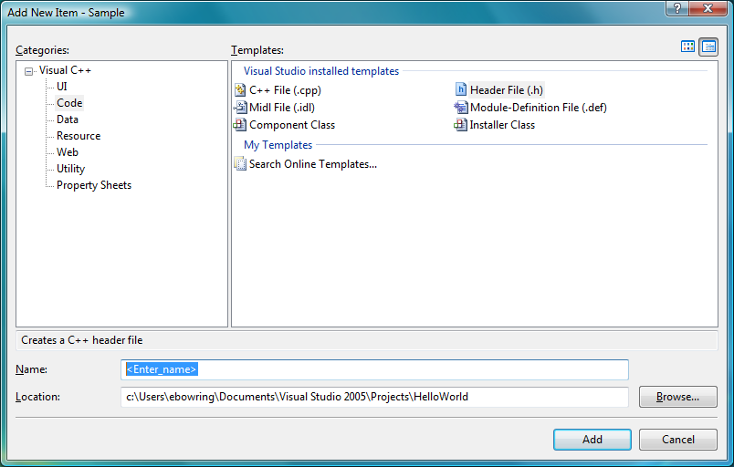
Visual Studio – Header Files
Right click on Header Files. Add → New Item.
Choose Header file (.h)
Enter Name myclass.h

Slide 15
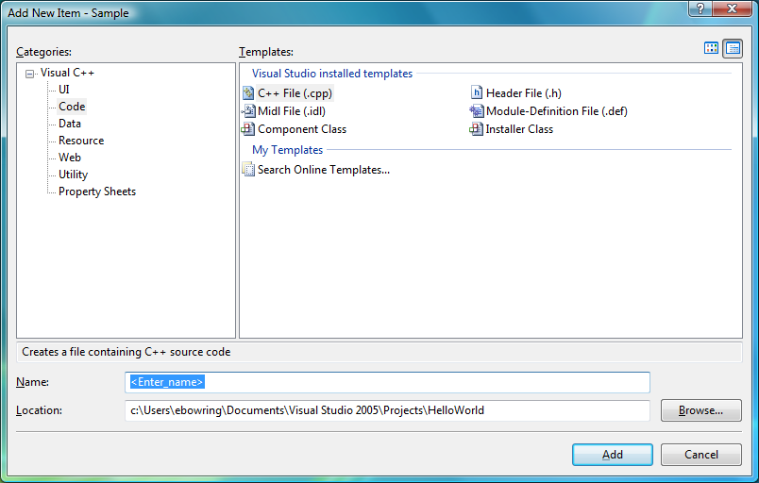
Visual Studio – Class Files
Right click on Source Files. Add → New Item.
Choose C++ file
Enter Name myclass.cpp

Slide 16
In Class Practice
Break Lab 1 into separate files
Use the wizard to create the new class Account
Define the properties
Add the default constructor
Add the getBalance and getRate definitions
Complete the wizard
Modify the account.cpp file
Move the class methods and operator code to here
Remove the class definition lines and fully qualify each of the methods to belong to the Account class.
Notes:
Note – Can’t have the short combination of the default and general constructor definitions. This needs to be separated into two separate methods (if needed).

Slide 17
Intro to Pointers
Pointers
Pointer variables
Memory management
Dynamic Arrays
Creating and using
Pointer arithmetic
Classes, Pointers, Dynamic Arrays
The this pointer
Destructors, copy constructors

Slide 18
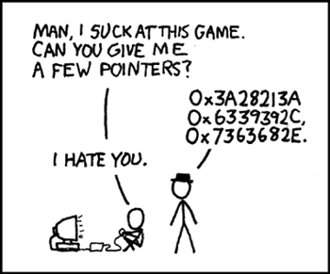
What is a Pointer?
Pointer definition:
Memory address of a variable
Recall: memory divided
Numbered memory locations
Addresses used as name for variable
You’ve used pointers already!
Call-by-reference parameters
Address of actual argument was passed

Slide 19
Variables and Memory
int x = 10;
int y = x;
5A111110
5A11111C
5A111127
5A111111
5A11111D
5A111128
5A111112
10
5A111129
y
5A111113
5A11111F
5A11112A
5A111114
5A11111F
5A11112B
10
5A111120
5A11112C
x
5A111116
5A111121
5A11112D
5A111117
5A111122
5A11112E
5A111118
5A111123
5A11112F
5A111119
5A111124
5A111130
5A11111A
5A111125
5A111131
5A11111B
5A111126
5A111132

Slide 20
Pointer Variables
int x = 10;
int y = x;
int* a = &x;
int* b = a;
int* c = &y;
5A111110
5A11111C
5A111127
5A111111
5A11111D
5A111128
5A111112
10
5A111129
y
5A111113
5A11111F
5A11112A
5A111114
5A11111F
5A11111E
c
10
5A111120
5A11112C
x
5A111116
5A111121
5A111115
a
5A111117
5A111122
5A11112E
5A111118
5A111123
5A11112F
Pointers are typed.
Ex., double* ptr;
int *p1, *p2;
5A111119
5A111124
5A111115
b
5A11111A
5A111125
5A111131
5A11111B
5A111126
5A111132

Slide 21
Pointing
Terminology, view
Talk of "pointing", not "addresses"
Pointer variable "points to" ordinary variable
Leave "address" talk out
Makes visualization clearer
"See" memory references
Arrows

Slide 22
Dereferencing Pointers
int x = 10;
int y = x;
int* a = &x;
cout << a << endl;
cout << *a << endl;
a = 5A111115;
*a = 10;
5A111110
5A11111C
5A111127
5A111111
5A11111D
5A111128
5A111112
10
5A111129
y
5A111113
5A11111F
5A11112A
5A111114
5A11111F
5A11112B
10
5A111120
5A11112C
x
5A111116
5A111121
5A111115
a
5A111117
5A111122
5A11112E
5A111118
5A111123
5A11112F
5A111119
5A111124
5A111130
5A11111A
5A111125
5A111131
5A11111B
5A111126
5A111132

Slide 23
Dereferencing Pointers
int x = 10;
int y = x;
int* a = &x;
cout << a << endl;
cout << *a << endl;
a = 5A111115;
*a = 10;
5A111110
5A11111C
5A111127
5A111111
5A11111D
5A111128
5A111112
10
5A111129
y
5A111113
5A11111F
5A11112A
5A111114
5A11111F
5A11112B
10
5A111120
5A11112C
x
5A111116
5A111121
5A11111E
a
5A111117
5A111122
5A11112E
5A111118
5A111123
5A11112F
5A111119
5A111124
5A111130
5A11111A
5A111125
5A111131
5A11111B
5A111126
5A111132

Slide 24
Dereferencing Pointers
int x = 10;
int y = x;
int* a = &x;
cout << a << endl;
cout << *a << endl;
a = 5A111115;
*a = 10;
5A111110
5A11111C
5A111127
5A111111
5A11111D
5A111128
5A111112
50
5A111129
y
5A111113
5A11111F
5A11112A
5A111114
5A11111F
5A11112B
10
5A111120
5A11112C
x
5A111116
5A111121
5A111115
a
5A111117
5A111122
5A11112E
5A111118
5A111123
5A11112F
5A111119
5A111124
5A111130
5A11111A
5A111125
5A111131
5A11111B
5A111126
5A111132

Slide 25
Pointers → Vars → Pointers
&x:
“address of x”
x is a regular var.
&x is a pointer
*p:
“what p points at” or “contents of p”
p is a pointer
*p is a regular var.

Slide 26
More "Pointing to" Examples
Consider: v1 = 0; p1 = &v1; *p1 = 42; cout << v1 << endl; cout << *p1 << endl;
Produces output: 42 42
p1 and v1 refer to same variable

Slide 27
& Operator
Remember call-by-reference parameters
Void sumxy(int &x, int y) { … }
Actually passes the "address of" actual argument
Operator’s two uses are closely related

Slide 28
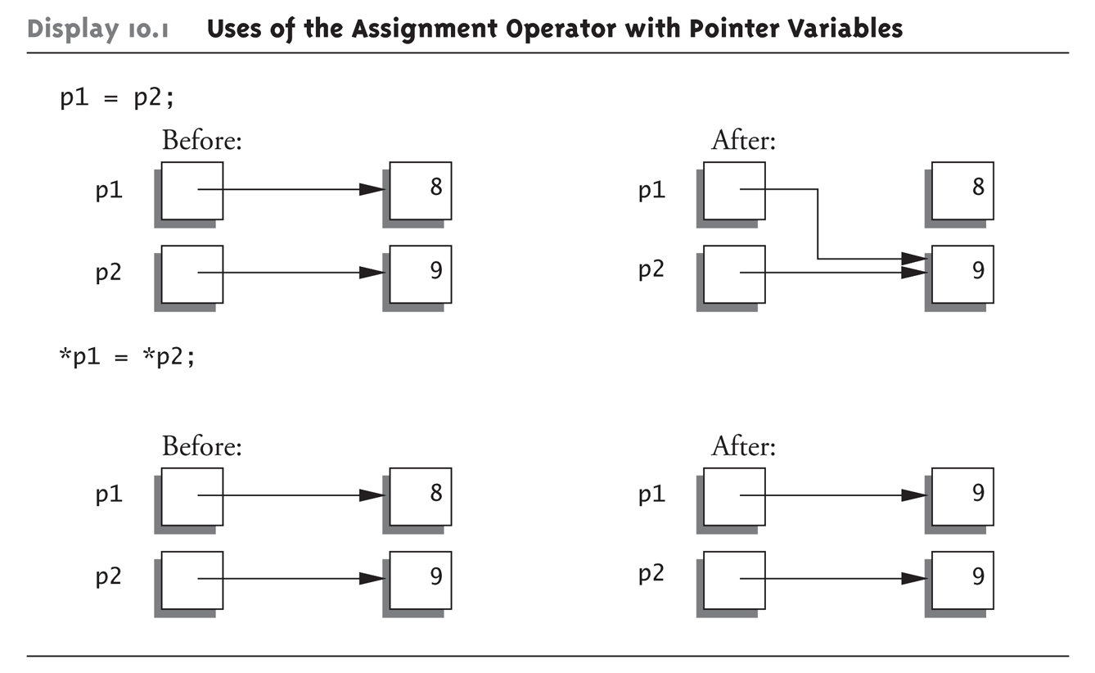
Pointer Assignments Graphic: Display 10.1 Uses of the Assignment Operator with Pointer Variables
*p represents the contents of the pointer

Slide 29
In Class Practice
Complete the worksheet / hand out of pointer examples.

Slide 30
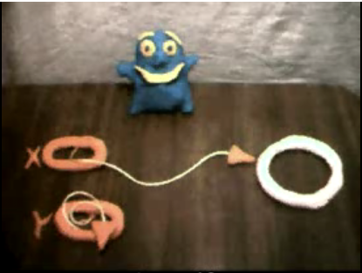
Dynamic Memory Allocation The New keyword
Dynamically allocate variables
Operator new creates variables
No identifiers to refer to them
Just a pointer!
p1 = new int;
Creates new "nameless" variable, and assigns p1 to "point to" it
Can access with *p1
Use just like ordinary variable
See this in action
http://www.youtube.com/watch?v=f-pJlnpkLp0

Slide 31
Dynamically Allocated Variables
int *p1, *p2;
p1 = new int;
*p1 = 5;
p2 = p1;
*p2 = 8;
p1 = new int;
*p1 = 3;
p2 = p1;
p1
NULL
NULL
p2

Slide 32
Dynamically Allocated Variables
int* p1, *p2;
p1 = new int;
*p1 = 5;
p2 = p1;
*p2 = 8;
p1 = new int;
*p1 = 3;
p2 = p1;
p1
NULL
p2

Slide 33
Dynamically Allocated Variables
int* p1, *p2;
p1 = new int;
*p1 = 5;
p2 = p1;
*p2 = 8;
p1 = new int;
*p1 = 3;
p2 = p1;
5
p1
NULL
p2

Slide 34
Dynamically Allocated Variables
int* p1, *p2;
p1 = new int;
*p1 = 5;
p2 = p1;
*p2 = 8;
p1 = new int;
*p1 = 3;
p2 = p1;
5
p1
p2

Slide 35
Dynamically Allocated Variables
int* p1, *p2;
p1 = new int;
*p1 = 5;
p2 = p1;
*p2 = 8;
p1 = new int;
*p1 = 3;
p2 = p1;
8
p1
p2

Slide 36
Dynamically Allocated Variables
int* p1, *p2;
p1 = new int;
*p1 = 5;
p2 = p1;
*p2 = 8;
p1 = new int;
*p1 = 3;
p2 = p1;
8
p1
p2

Slide 37
Dynamically Allocated Variables
int* p1, *p2;
p1 = new int;
*p1 = 5;
p2 = p1;
*p2 = 8;
p1 = new int;
*p1 = 3;
p2 = p1;
8
p1
3
p2

Slide 38

Dynamically Allocated Variables
int* p1, *p2;
p1 = new int;
*p1 = 5;
p2 = p1;
*p2 = 8;
p1 = new int;
*p1 = 3;
p2 = p1;
8
p1
Oops!
3
p2

Slide 39
More on new Operator
Creates new dynamic variable
Returns pointer to the new variable
If type is class (object) :
Constructor is called for new object
Can invoke different constructor with initializer arguments: MyClass *mcPtr; mcPtr = new MyClass(32.0, 17);
Can still initialize non-class types: int *n; n = new int(17); //Initializes *n to 17
double* dPtr = new double;
double* ePtr = new double(13.2);
char* cPtr = new char;
Neuron* nPtr = new Neuron;
nPtr->method();
Date* fPtr = new Date(12, “Mar”, 2006);
fPtr->month;

Slide 40
Pointers and Functions
Can be function parameters
Can be returned from functions
Example: int* findOtherPointer(int* p);
This function declaration:
Has "pointer to an int" parameter
Returns "pointer to an int" variable

Slide 41
delete Operator
De-allocate dynamic memory (good housekeeping)
Returns memory to computer
Example: int *p; p = new int(5); … //Some processing… delete p;
Destroys dynamic memory "pointed to by pointer p“
Avoid dangling pointers
Assign pointer to NULL after delete: delete p; p = NULL;

Slide 42
In Class Pointer Practice
Create new project called pointerpractice
Define an array of doubles with size = 20 elements
Define two pointers
Assign the first one to the beginning of the array.
Assign the second to the end (Hint – need to de-reference the last element)
Calculate the size of the array
Display the begin and end address and the size

Slide 43
Dynamic Arrays
int size = 0;
cout << “Enter length of word: “;
cin >> size;
char myarray[size];
char* arrPtr = new char [size];
Remember from COMP 51 that this was a compiler error

Slide 44
Accessing Dynamic Arrays
Using Array Notation
arrPtr[2] = 5;
Using Pointer Notation
*(arrPtr + 2) = 5;
Walking Pointers Through
while (ptr1 < ptr2) ptr1++;

Slide 45

Cleaning Up Your Program
int* p = new int (5);
delete p;
int* p = new int [5];
delete [ ] p;
Allocates 5 total integers = 20 bytes

Slide 46
Key Takeaways
When a program gets too big…
You can break it down into smaller blocks of code
Assign code blocks to team members
Pointers
Can be painful fun!
Enable dynamic memory usage
Foundation of many data structures
Remember to “clean your program – young lady/man”
Use ________ command

